Slide 1

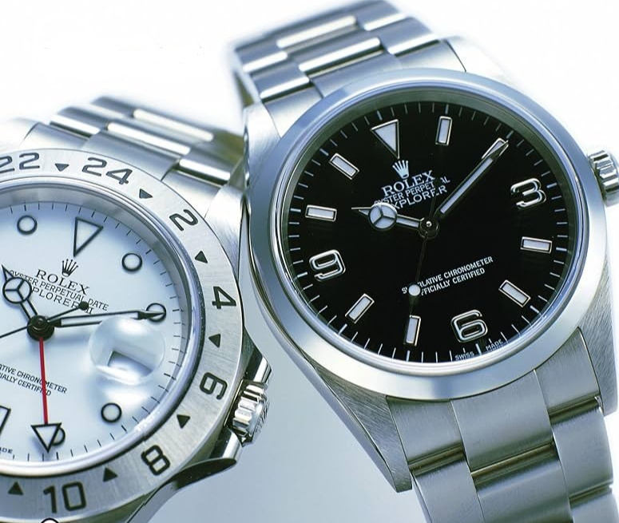
# New style
ROLEX
3.621 WRISTWATCHES
Rolex
Cosmograph Daytona
Panda men’s
A
crown
For
Every
Acievement
$25,995
Link:www.rolex.in

